Slide 1
Sentiment Analysis Assignment
AIDI1006 - AI Infrastructure and Arch.
Assignment 4
Team Members:
Cheuk Ying Iu (200514612)
Fangji Chen (200520598)

Slide 2
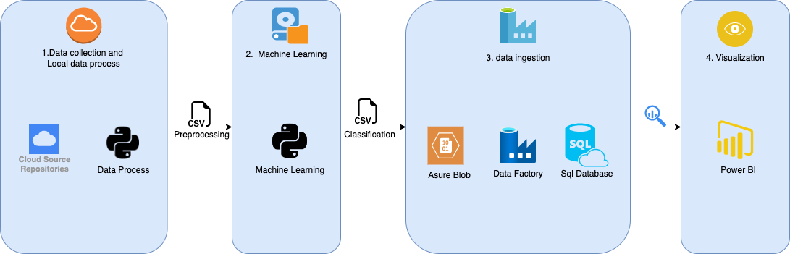
Project Architecture
As the initial step. We collect the right data from the internet and preprocessed it with python code.
Then, we trained a model with python machine learning modules to make classification.
After that, we import the outcomes of the classification stage to Asure Blob Storage. And with the help of Asure Data Factory, we load the raw data into Asure SQL Database.
Finally, we use Power BI to visualize the classification results clearly.

Slide 3
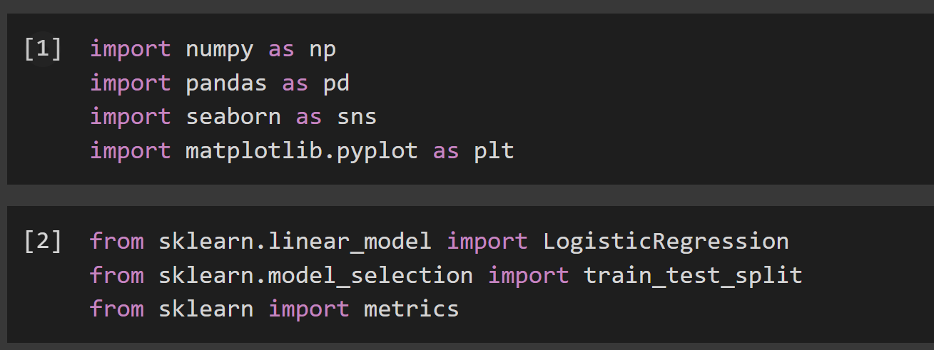
Library Used
Python
Numpy
Pandas
Sklearn
LogisticRegression
Train_test_split
metrics

Slide 4
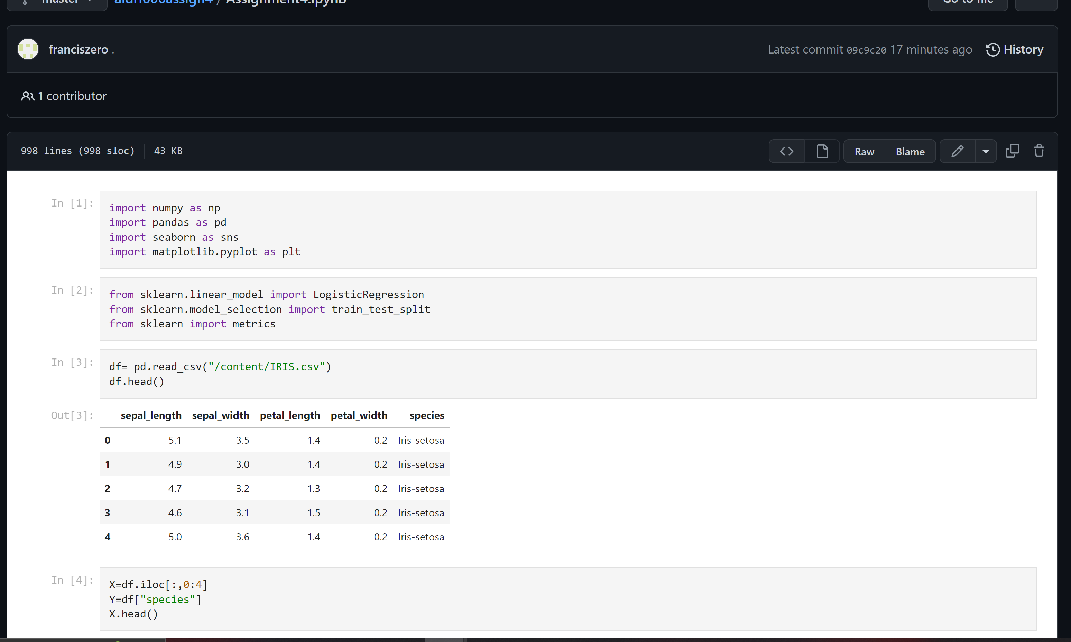
Code Used (Github)
https://github.com/franciszero/aidi1006assign4/blob/master/Assignment4.ipynb
Iris Flowers Classification
Logistic Regression

Slide 5
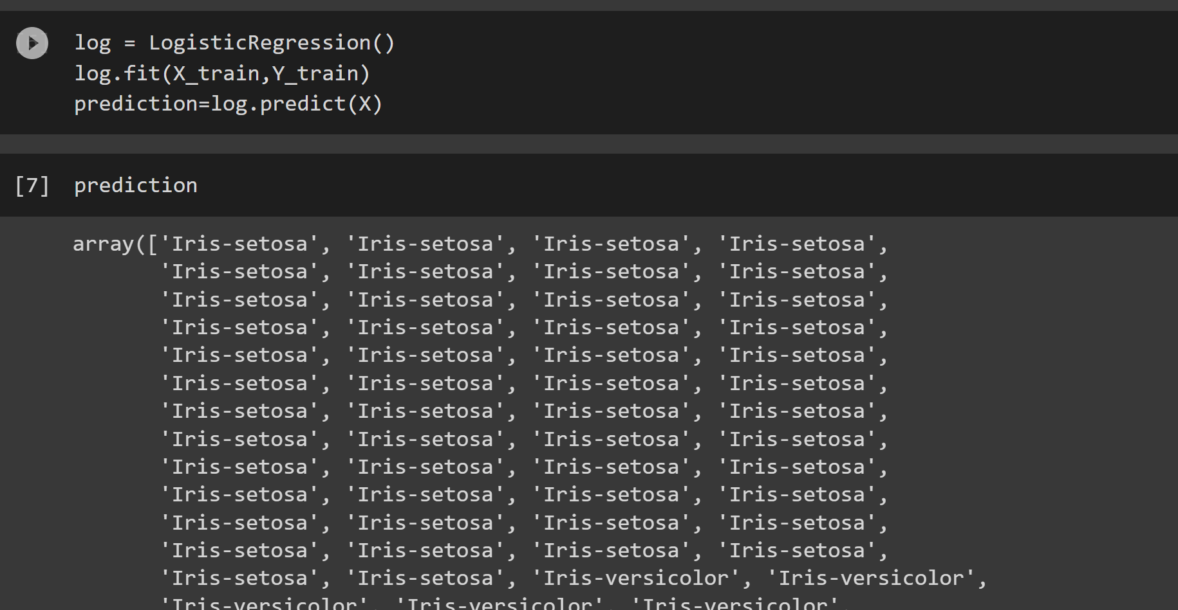
Prediction (Running Code)

Slide 6
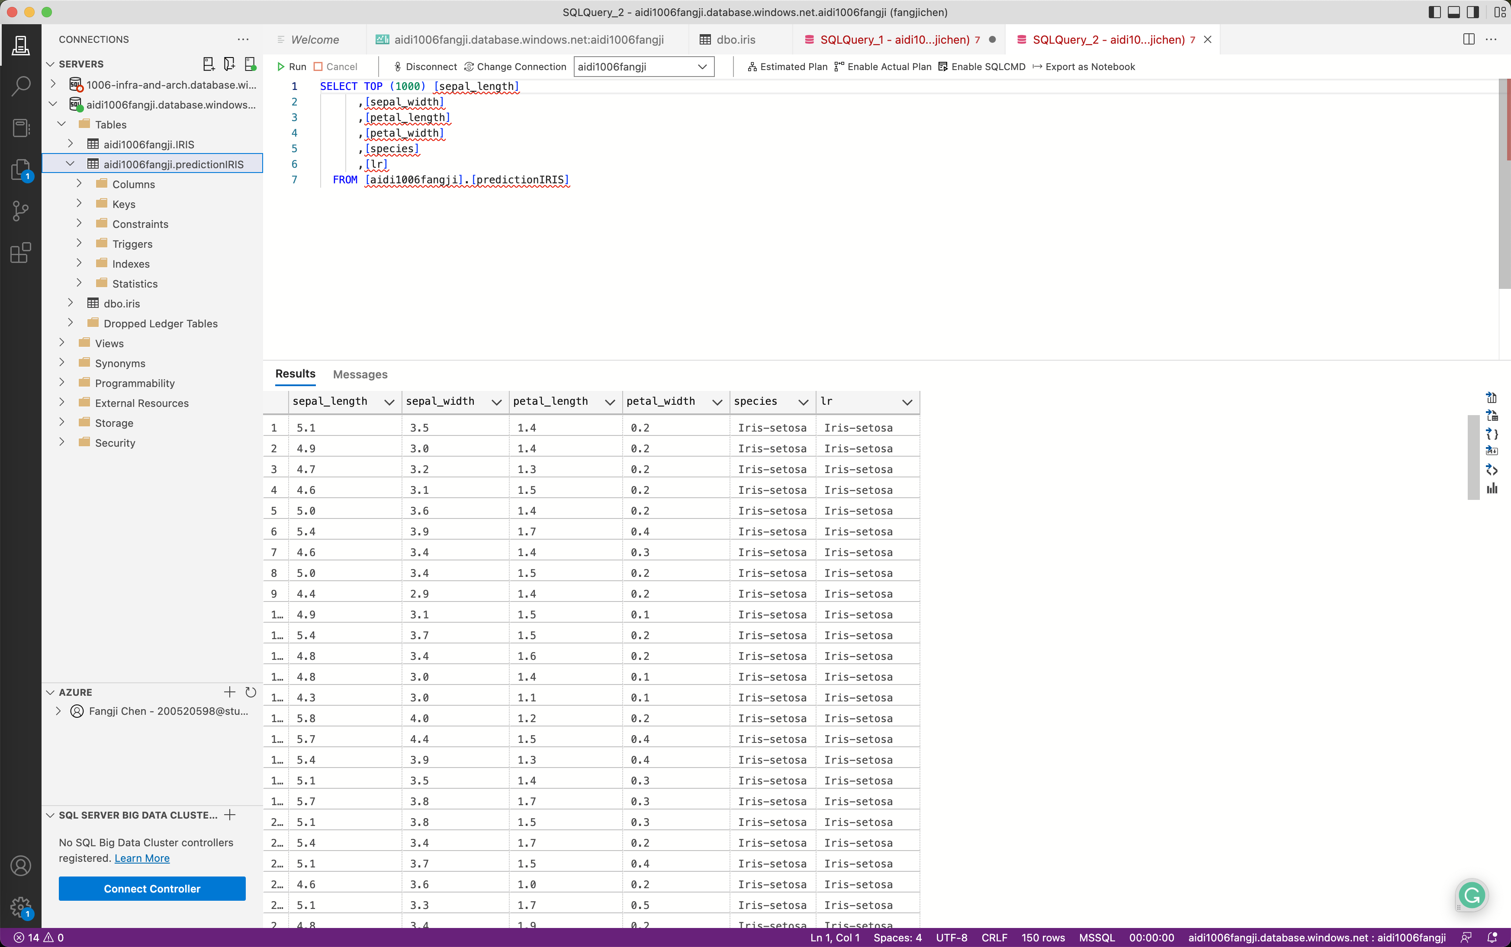
ADF (Azure Data Factory)

Slide 7
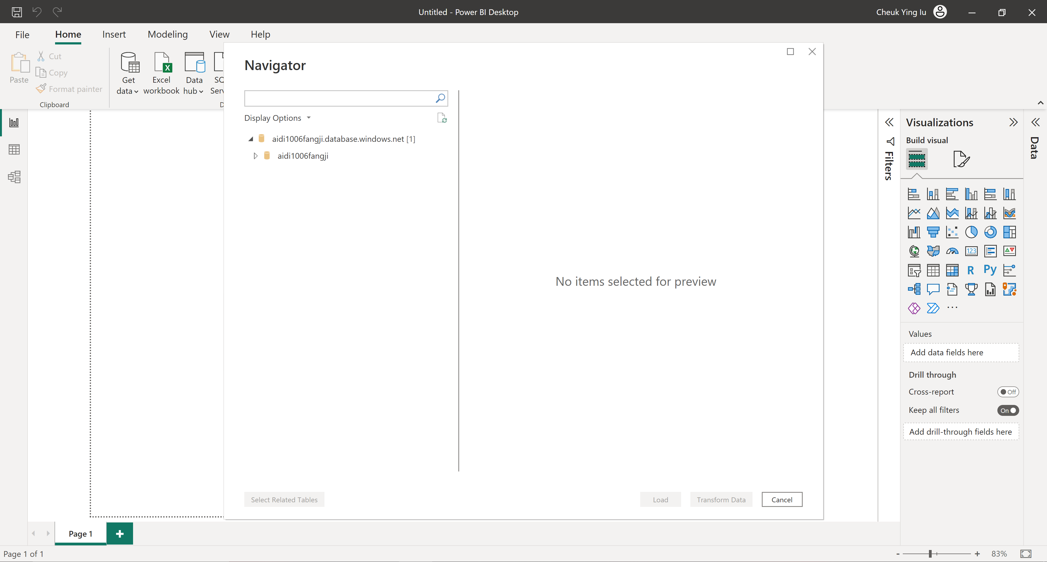
PowerBI (Get data from the SQL Server)

Slide 8
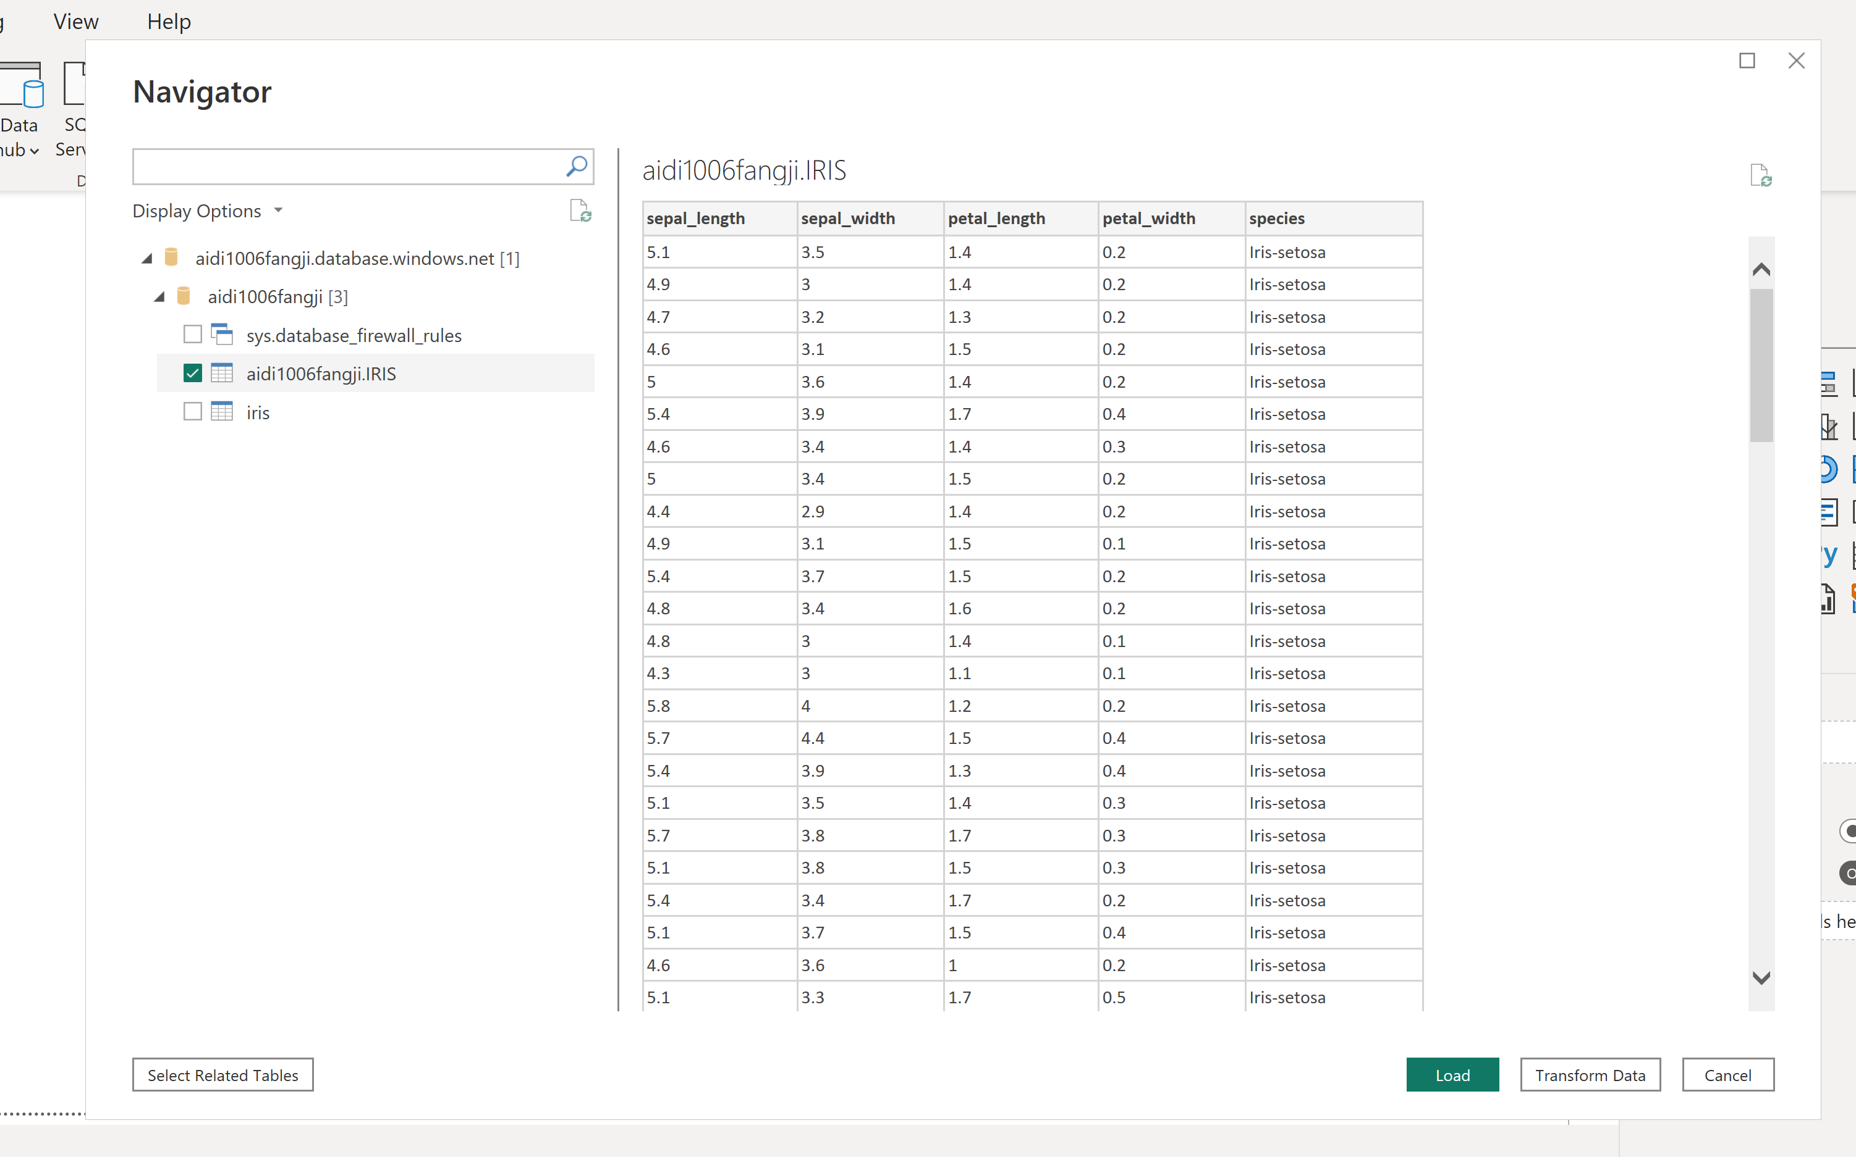
PowerBI (Iris Dataset)

Slide 9
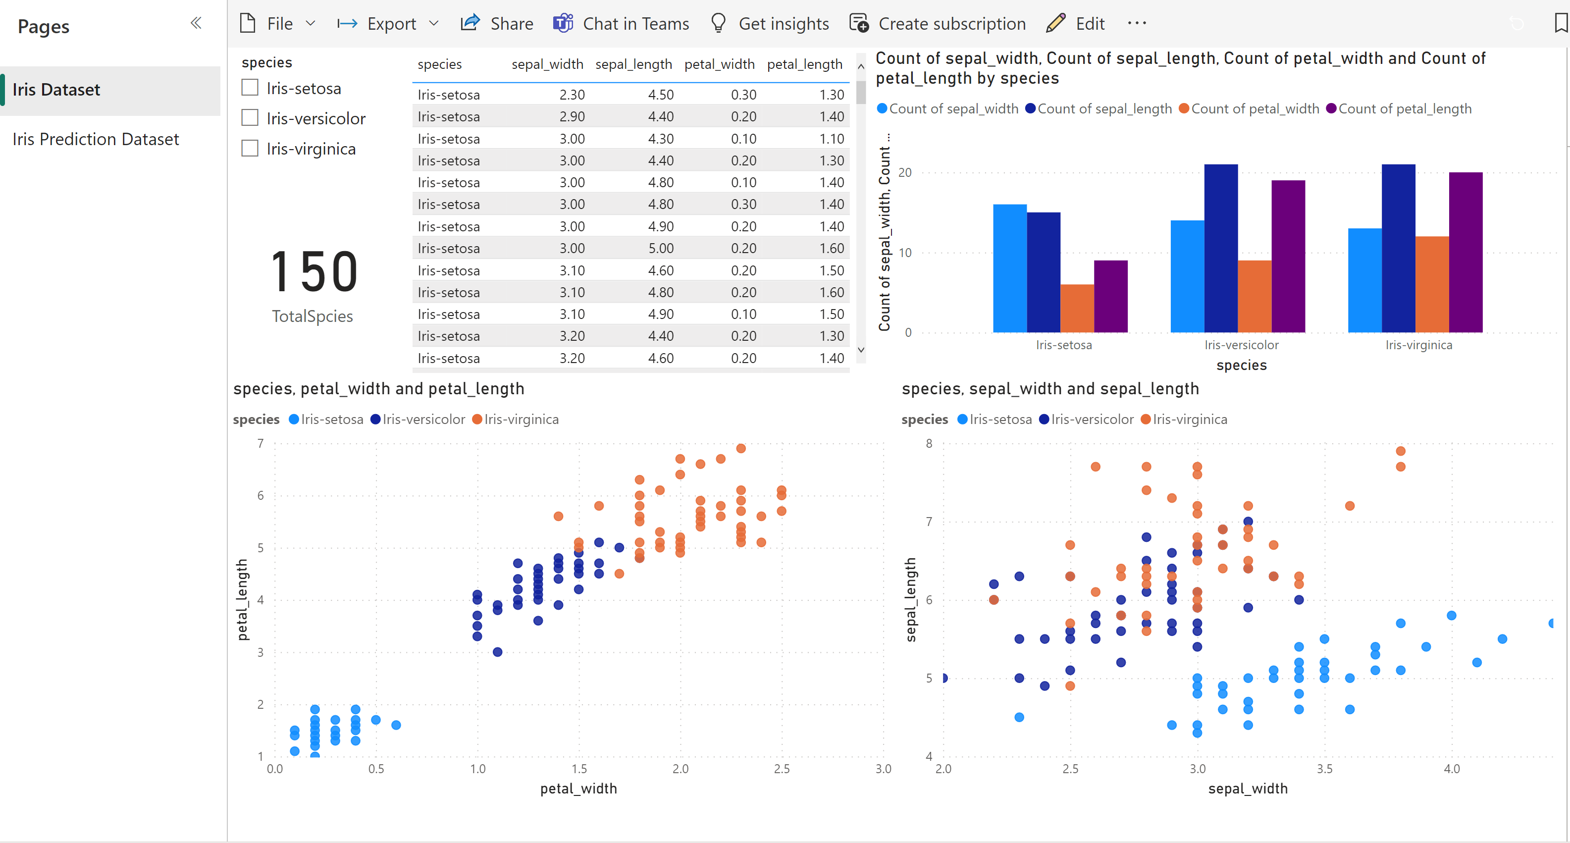
PowerBI Dashboard (Iris Dataset)

Slide 10
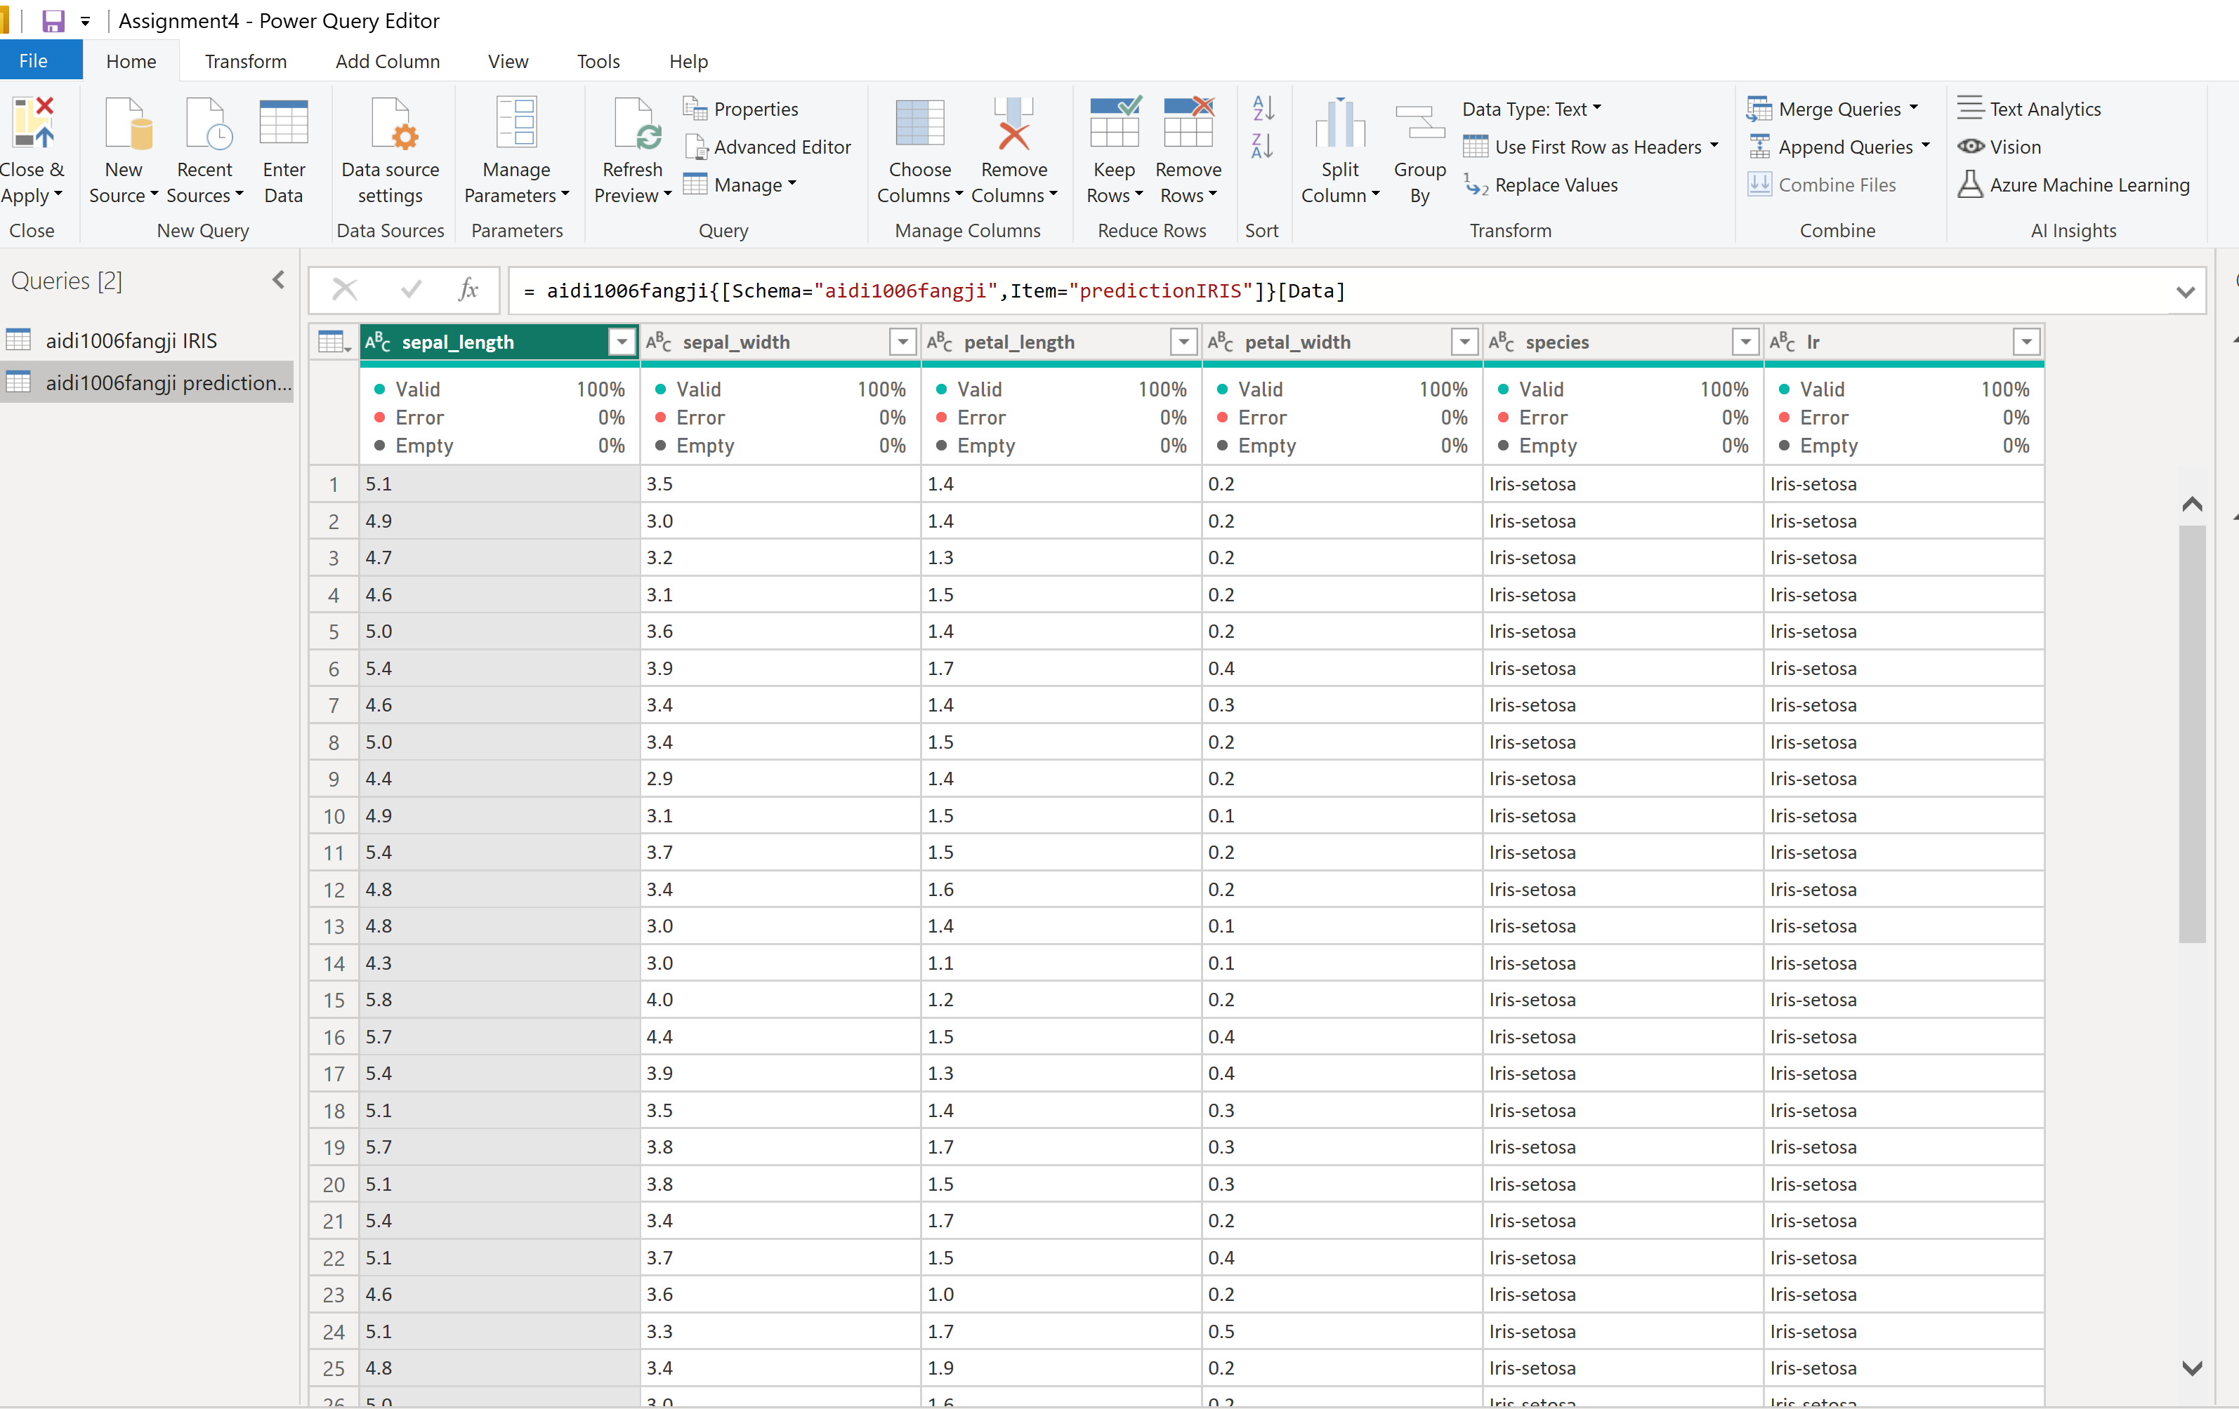
PowerBI (Iris Prediction Dataset)

Slide 11
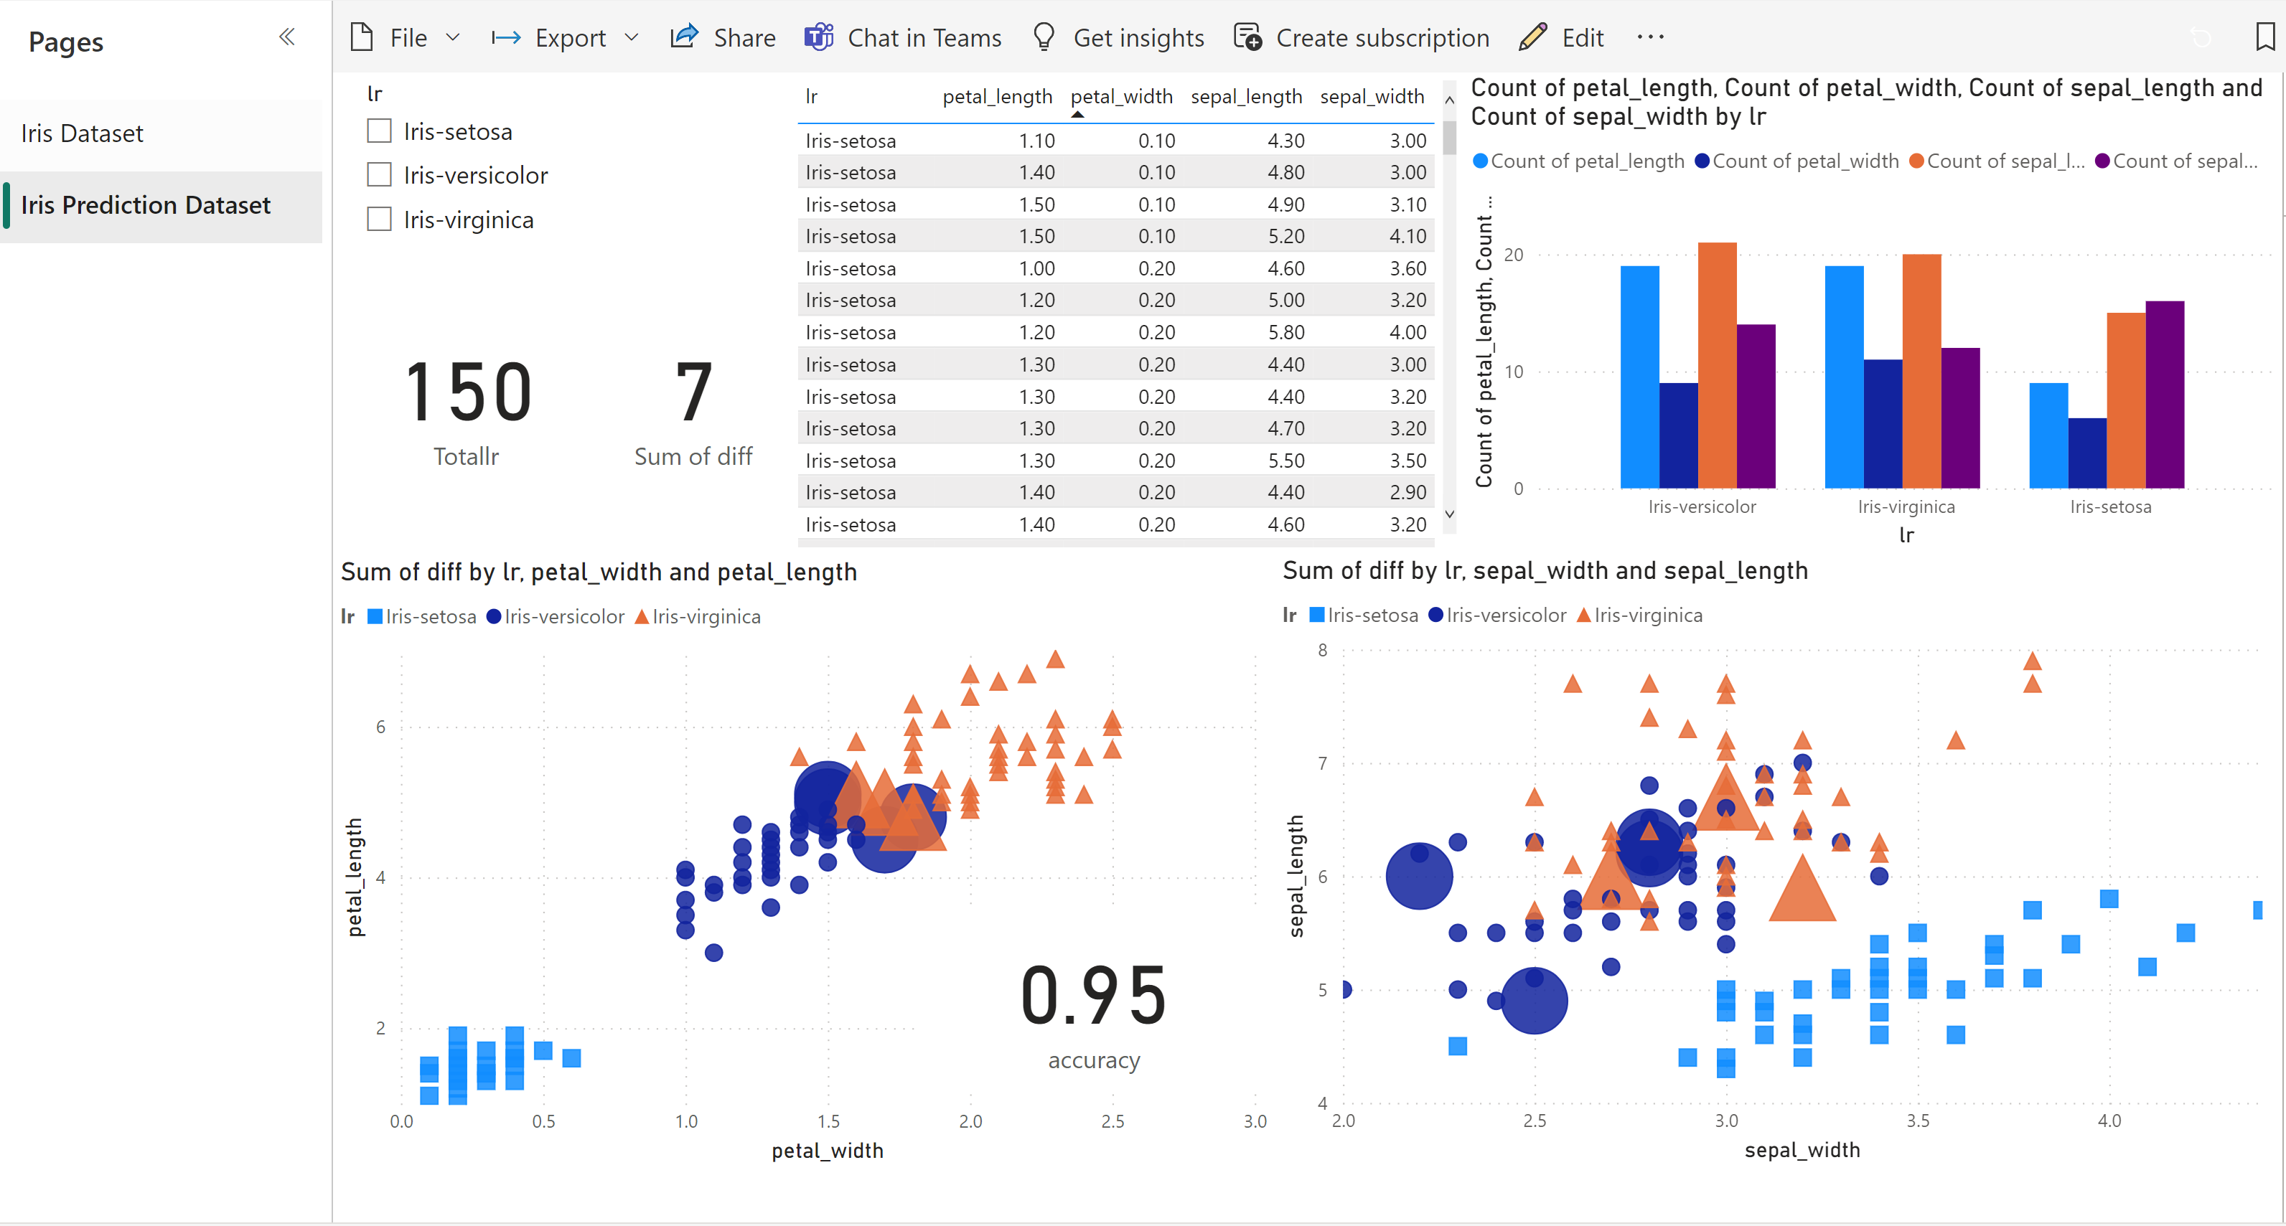
PowerBI Dashboard (Iris Prediction Dataset)
As we can this from this page, we emphasized 6 wrong samples in a larger size.
And got an accuracy score at 95%.

